Slide 1
Using Big Data To Solve
Economic and Social Problems
Professor Raj Chetty
Head Section Leader Rebecca Toseland
Photo Credit: Florida Atlantic University

Slide 2
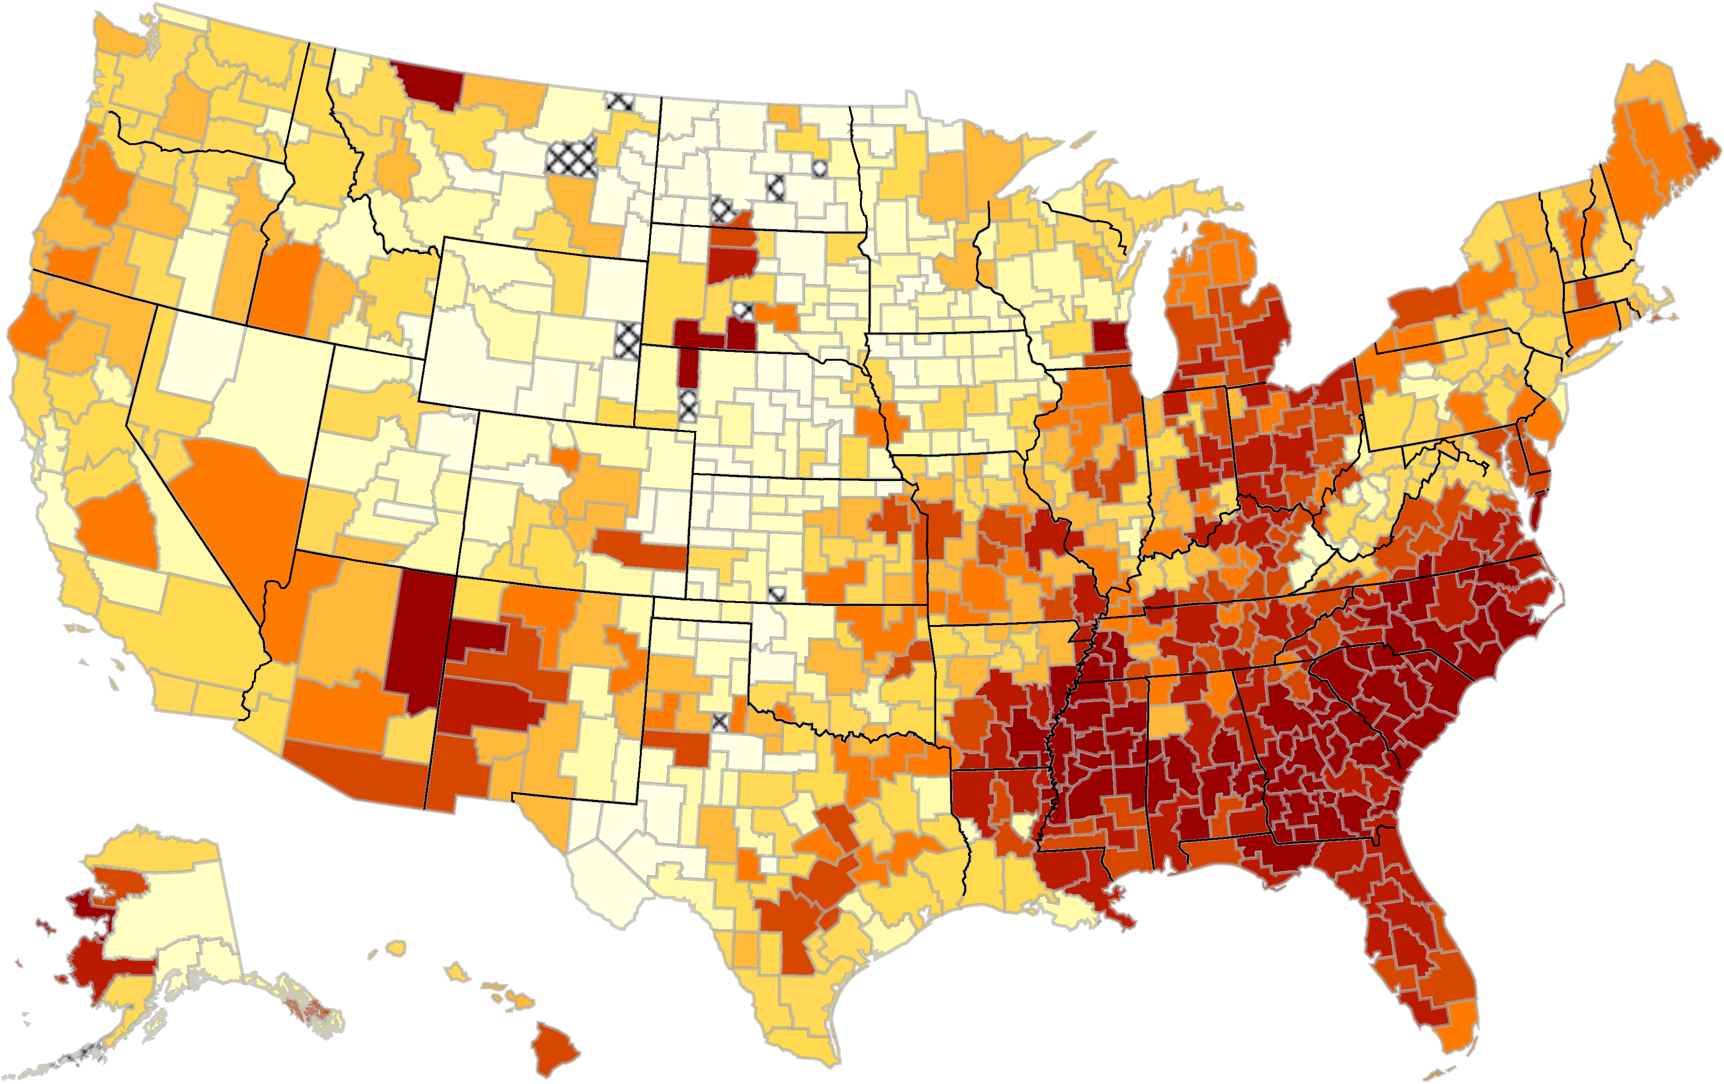
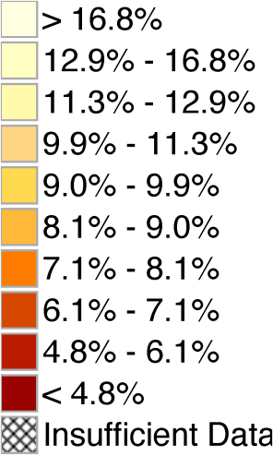
The Geography of Upward Mobility in the United States
Probability of Reaching the Top Fifth Starting from the Bottom Fifth
Note: Lighter Color = More Upward Mobility
Download Statistics for Your Area at www.equality-of-opportunity.org

Slide 3
Policies to Increase Upward Mobility
How can we increase upward mobility in areas with low rates of mobility?
One approach: place-based policies that try to address problems in low-opportunity areas
Five correlations identified in last lecture provide some clues about factors that might matter
But little hard evidence to date on what place-based policies actually work

Slide 4
Policies to Increase Upward Mobility
Alternative approach: help families move to higher-opportunity areas using affordable housing policies
Even if we don’t know why these areas produce better outcomes, this could increase upward mobility
This lecture: discuss this “moving to opportunity” approach to increase mobility
Methodological focus: randomized experiments
Reference: Chetty, Hendren, Katz. “The Long-Term Effects of Exposure to Better Neighborhoods: New Evidence from the Moving to Opportunity Experiment” AER 2016.

Slide 5
Affordable Housing Policies
Many potential policies to help low-income families move to better neighborhoods:
Subsidized housing vouchers to rent better apartments
Mixed-income affordable housing developments
Changes in zoning regulations and building restrictions
Are such housing policies effective in increasing social mobility?
Useful benchmark: cash grants of an equivalent dollar amount to families with children

Slide 6
Affordable Housing Policies
Economic theory predicts that cash grants of an equivalent dollar amount are better than expenditures on housing
Yet the U.S. spends $45 billion per year on housing vouchers, tax credits for developers, and public housing
Are these policies effective, and how can they be better designed to improve social mobility?
Study this question here by focusing specifically on the role of housing vouchers for low-income families

Slide 7
Studying the Effects of Housing Vouchers
Question: will a given child i’s earnings at age 30 (Y_{i}) be higher if his/her family receives a housing voucher?
Definitions:
Y_{i}(V=1) = child’s earnings if family gets voucher
Y_{i}(V=0) = child’s earnings if family does not get voucher
Goal: estimate
G = Y_{i}(V=1) – Y_{i}(V=0)

Slide 8
Studying the Effects of Housing Vouchers
Fundamental problem in empirical science: we do not observe Y_{i}(V=1) and Y_{i}(V=0) for the same person
We only see one of the two potential outcomes for each child
Either the family received a voucher or didn’t…
How can we solve this problem?
This is the focus of research on causality in statistics

Slide 9
Randomized Experiments
Gold standard solution: run a randomized experiment (“A/B testing”)
Example: take 10,000 children and flip a coin to determine if they get a voucher or not
Difference in average earnings across the two groups equals the causal effect of getting the voucher (G)
Intuition: two groups are identical except for getting voucher → difference in earnings capture causal effect of voucher

Slide 10
Importance of Randomization
Suppose we instead compared 10,000 people, half of whom applied for a voucher and half of whom didn’t
Could still compare average earnings in these two groups
But in this case, there is no guarantee that differences in earnings are only driven by the voucher
There could be many other differences across the groups:
Those who applied may be more educated
Or they may live in worse areas to begin with
Randomization eliminates all other such differences

Slide 11
Non-Compliance in Randomized Experiments
Common problem in randomized experiments: non-compliance
In medical trials: patients may not take prescribed drugs
In voucher experiment: families offered a voucher may not actually use it to rent a new apartment
We can’t force people to comply with treatments; we can only offer them a treatment
How can we learn from experiments in the presence of such non-compliance?

Slide 12
Adjusting for Non-Compliance
Solution: adjust estimated impact for rate of compliance
Example: suppose half the people offered a voucher actually used it to rent a new apartment
Suppose raw difference in earnings between those offered voucher and not offered voucher is $1,000
Then effect of using voucher to rent a new apartment must be $2,000 (since there is no effect on those who don’t move)
More generally, divide estimated effect by rate of compliance:
True Impact = Estimated Impact/Compliance Rate

Slide 13
Moving to Opportunity Experiment
Implemented from 1994-1998 at 5 sites: Baltimore, Boston, Chicago, LA, New York
4,600 families living in high-poverty public housing projects were randomly assigned to one of three groups:
Experimental: offered housing vouchers restricted to low-poverty (<10%) Census tracts
Section 8: offered conventional housing vouchers, no restrictions
Control: not offered a voucher, stayed in public housing
Compliance rates: 48% of experimental group used voucher, 66% of Section 8 group used voucher

Slide 14
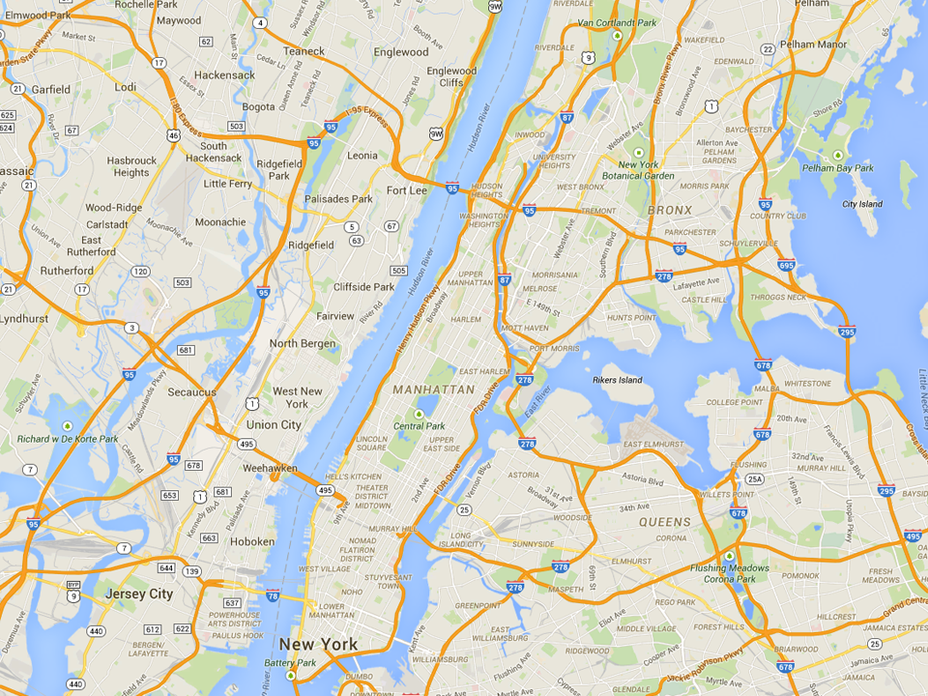
Common MTO Residential Locations in New York
Experimental
Wakefield Bronx
Section 8
Soundview Bronx
Control
ML King Towers
Harlem

Slide 15
Analysis of MTO Experimental Impacts
Prior research on MTO has found little impact of moving to a better area on economic outcomes such as earnings
But has focused on adults and older youth at point of move [e.g., Kling, Liebman, and Katz 2007]
Motivated by quasi-experimental study discussed in last lecture, we test for exposure effects among children
Does MTO improve outcomes for children who moved when young?
Link MTO to tax data to study children’s outcomes in mid 20’s
Compare earnings across groups, adjusting for compliance rates

Slide 16
Impacts of MTO on Children Below Age 13 at Random Assignment
(a) Earnings
(b) College Attendance
17000
25
15000
20
13000
15
Individual Earnings at Age ≥ 24 ($)
College Attendance, Ages 18-20 (%)
11000
10
9000
$11,270
$12,994
$14,747
16.5%
18.0%
21.7%
5
7000
p = 0.101
p = 0.014
p = 0.435
p = 0.028
5000
0
Control
Section 8
Experimental
Voucher
Control
Section 8
Experimental
Voucher

Slide 17
Impacts of MTO on Children Below Age 13 at Random Assignment
(c) Neighborhood Quality
(d) Fraction Single Mothers
25
37.5
23
25
21
ZIP Code Poverty Rate (%)
Birth with no Father Present (%)
19
12.5
17
23.8%
21.7%
20.4%
33.0%
31.0%
23.0%
p = 0.046
p = 0.007
p = 0.610
p = 0.042
15
0
Control
Section 8
Experimental
Voucher
Control
Section 8
Experimental
Voucher

Slide 18
Impacts of MTO on Children Age 13-18 at Random Assignment
(a) Earnings
(b) Fraction Single Mothers
17000
62.5
15000
50
13000
37.5
Individual Earnings at Age ≥ 24 ($)
Birth with no Father Present (%)
11000
25
9000
$15,882
$13,830
$13,455
41.4%
40.2%
51.8%
7000
p = 0.219
p = 0.259
12.5
p = 0.857
p = 0.238
5000
0
Control
Section 8
Experimental
Voucher
Control
Section 8
Experimental
Voucher

Slide 19
Impacts of Moving to Opportunity on Adults’ Earnings
17000
15000
13000
Individual Earnings at Age ≥ 24 ($)
11000
9000
$14,381
$14,778
$13,647
7000
p = 0.711
p = 0.569
5000
Control
Section 8
Experimental
Voucher

Slide 20
Limitations of Randomized Experiments
Why not use randomized experiments to answer all policy questions?
Beyond feasibility, there are three common limitations:
Attrition: lose track of participants over time → long-term impact evaluation unreliable
Especially a problem when attrition rate differs across treatment groups because we lose comparability
This problem is largely fixed by the “big data” revolution: in MTO, we are able to track 99% of participants by linking to tax records

Slide 21
Limitations of Randomized Experiments
Why not use randomized experiments to answer all policy questions?
Beyond feasibility, there are three common limitations:
Attrition: lose track of participants over time → long-term impact evaluation unreliable
Sample size: small samples make estimates imprecise, especially for long-term impacts
This problem is not fixed by big data: cost of data has fallen, but cost of experimentation (in social science) has not

Slide 22
Impacts of Experimental Voucher by Age of Random Assignment
Household Income, Age ≥ 24 ($)
4000
2000
0
Experimental Vs. Control ITT on Income ($)
-2000
-4000
-6000
10
12
14
16
Age of Child at Random Assignment

Slide 23
Limitations of Randomized Experiments
Why not use randomized experiments to answer all policy questions?
Beyond feasibility, there are three common limitations:
Attrition: lose track of participants over time → long-term impact evaluation unreliable
Sample size: small samples make estimates imprecise, especially for long-term impacts
Generalizability: results of an experiment may not generalize to other subgroups or areas
Difficult to run experiments in all subgroups and areas → “scaling up” can be challenging

Slide 24
Quasi-Experimental Methods
Quasi-experimental methods using big data can address these issues
Consider study of 7 million families that moved across areas discussed in last lecture (Chetty and Hendren 2016)
How did we achieve comparability across groups in this study?
People who move to different areas are not comparable to each other
But people who move when children are younger vs. older are more likely to be
→ Approximate experimental conditions by comparing children who move to a new area at different ages

Slide 25
Quasi-Experimental Methods
Quasi-experimental approach addresses limitations of MTO experiment:
Sample size: much larger samples yield precise estimates of childhood exposure effects (linear, 4% convergence per year)
Generalizability: results generalize to all areas of the U.S.
Limitation of quasi-experimental approach: reliance on stronger assumptions
Bottom line: reassuring to have evidence from both approaches that is consistent → clear consensus that moving to opportunity works

Slide 26
Implications for Housing Voucher Policy
Housing vouchers can be very effective but must be targeted carefully
Vouchers should be targeted at families with young children
Current U.S. policy of putting families on waitlists is especially inefficient

Slide 27
Implications for Housing Voucher Policy
Housing vouchers can be very effective but must be targeted carefully
Vouchers should be targeted at families with young children
Vouchers should be explicitly designed to help families move to affordable, high-opportunity areas
In MTO experiment, unrestricted “Section 8” vouchers produced smaller gains even though families could have made same moves
More generally, low-income families rarely use cash transfers to move to better neighborhoods [Jacob et al. QJE 2015]
80% of the 2.1 million Section 8 vouchers are currently used in high-poverty, low-opportunity neighborhoods

Slide 28
Why Don’t More Low-Income Families Move to Opportunity?
One simple explanation: areas that offer better opportunity may be unaffordable
To explore this, we are constructing estimates of opportunity at narrower geographies, by ZIP code and Census tract
These data reveal that there are many opportunity bargains:
Areas with relatively low rents that offer good opportunities for kids

Slide 29
Opportunity Bargains at the ZIP Code Level in the New York Area
Preliminary Estimates
20
10
Park Slope
Rockaway Park
East Midwood
0
Wakefield
Opportunity Index: Effect on Child’s Earnings (%)
-10
Soundview
-20
MLK Towers
(Harlem)
-30
500
1,000
1,500
2,000
Average Monthly Rent in ZIP Code ($)

Slide 30
Creating Moves to Opportunity in Seattle
Help families with Housing Choice Vouchers in Seattle/King County
move to high opportunity areas using three approaches
INFORMATION & FINANCIAL ASSISTANCE
REDUCED LANDLORD BARRIERS
RENTAL BROKER ASSISTANCE
Source: Bergman, Chetty, DeLuca, Hendren, Katz, Palmer (in progress)

Slide 31
Integration through Housing Vouchers: Potential Concerns
Costs: is the voucher program too expensive to scale up?
Vouchers can save taxpayers money relative to public housing projects in long run

Slide 32
Impacts of MTO on Annual Income Tax Revenue in Adulthood
for Children Below Age 13 at Random Assignment
1200
1000
800
Annual Income Tax Revenue, Age ≥ 24 ($)
600
400
$447.5
$616.6
$841.1
200
p = 0.061
p = 0.004
0
Control
Section 8
Experimental
Voucher

Slide 33
Integration through Housing Vouchers: Potential Concerns
Costs: is the voucher program too expensive to scale up?
Negative spillovers: does integration hurt the rich?
Evaluate this by examining how outcomes of the rich vary across areas in relation to outcomes of the poor
Empirically, more integrated neighborhoods do not have worse outcomes for the rich on average…

Slide 34
Children’s Outcomes vs. Parents Incomes in Salt Lake City vs. Charlotte
70
60
50
Child Percentile in National Income Distribution
40
30
20
0
20
40
60
80
100
Parent Percentile in National Income Distribution
Salt Lake City
Charlotte

Slide 35
Integration through Housing Vouchers: Potential Concerns
Costs: is the voucher program too expensive to scale up?
Negative spillovers: does integration hurt the rich?
Limits to scalability
Moving everyone in Harlem to Bronx is unlikely to have significant effects
Ultimately need to turn to policies that increase integration in other ways rather than moving low-income families

